Slide 1
Soft Robotics Summer Internship Conclusion
Phoebe Scaccia

Slide 2
Building the Practice Forward and Inverse Models

Slide 3
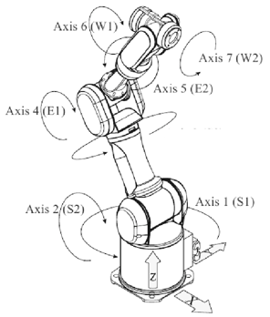
Practice Model Goals
Practice model to learn theory for the soft robot
Create forward and inverse kinematic models for the Mitsubishi PA-10 6-DOF robotic arm
Use Keras, a Python library
Data for my practice model from Sebastian Starke’s DeepIK repository
Notes:
Tasked with creating a practice neural network model before the soft-bodied robot
Data: 6 inputs (6 motors), 7 outputs (XYZ position + quaternion rotation)
Explain hidden layers, relu (only positive numbers), adam (algorithm that determines the individual learning rate for each weight in the model)
Don’t know what MSE quite means in this case, and how to relate it to the robot’s range
Rotate one motor at a time to find the source of the error (physical validation)

Slide 4
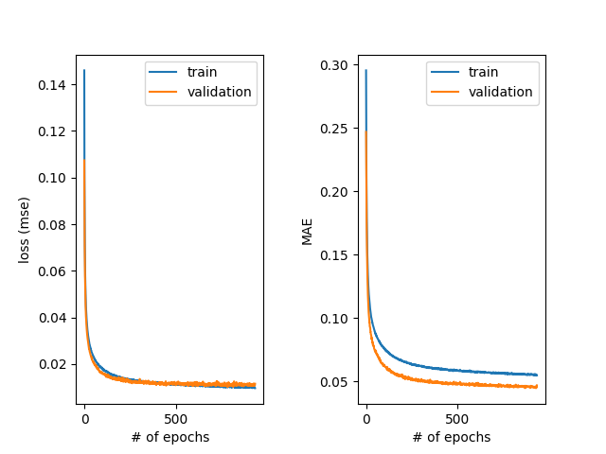
Forward Kinematics Model
Mean squared error (MSE): 0.01
Three hidden layers
Each has a dropout of 0.05
ReLU activation
Adam optimizer
Early stopping when the model stops learning

Slide 5
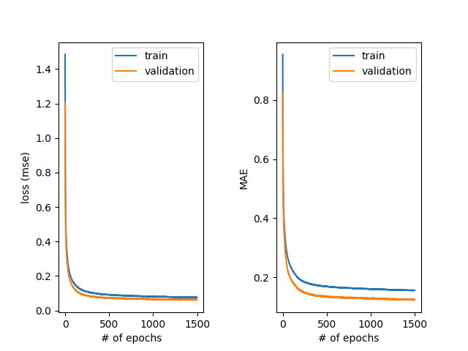
Inverse Kinematics Model
Same design as the forward kinematics model
MSE: 0.06
Harder to train than the forward model
One-to-many function

Slide 6
Manually Testing the Forward and Inverse Models

Slide 7
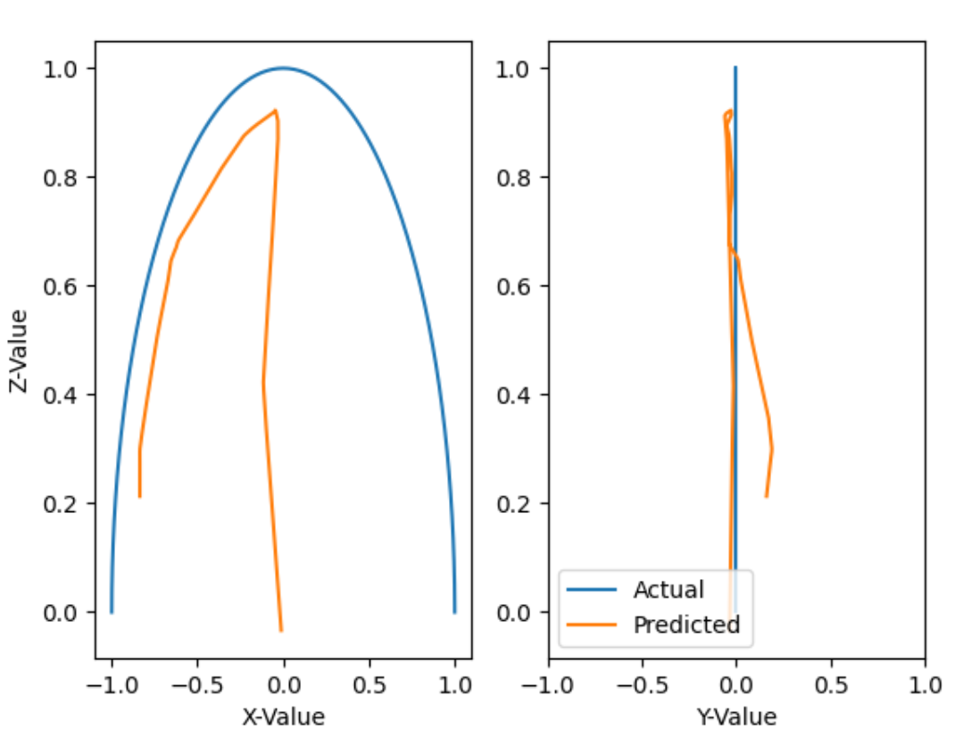
Forward Kinematics Model
Rotated motor two from -π/2 to π/2
Kept the other motors at 0
Encountered a strange issue where the model couldn’t accurately predict positive motor angles

Slide 8
Given Robot Data Exploration
Filter given data points to be within ±0.5 of my manually created points
33 points, which is as to be expected
Data points close to manual testing points are limited to negative motor 2 rotations
Explains why model performed poorly for positive motor 2 rotations
Actual Z range seems to be 0.1 lower than manually computed
May be a limitation of the robot
Change calculated data range to account for this (multiply by 0.9)
Predicted data seems close to manual and given data at similar motor 2 rotations with reasonable error from other motors

Slide 9
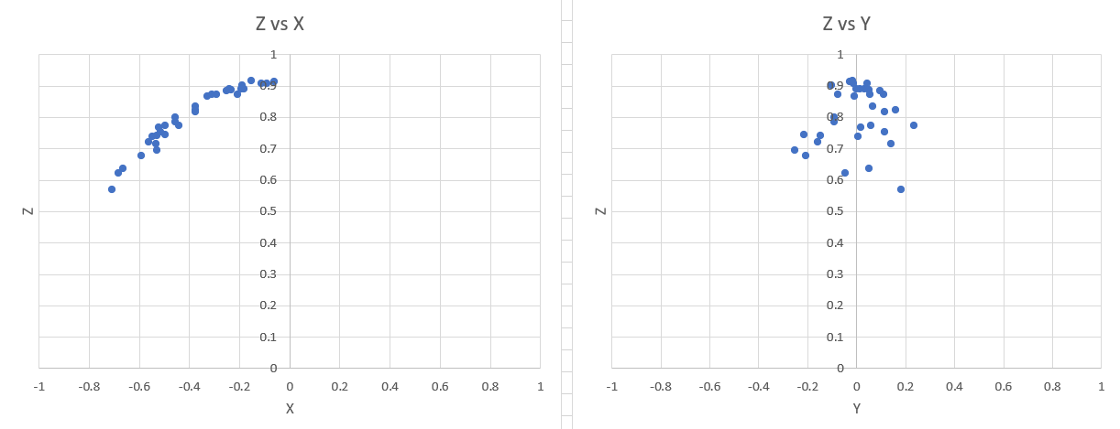
Data points near the manually calculated values

Slide 10
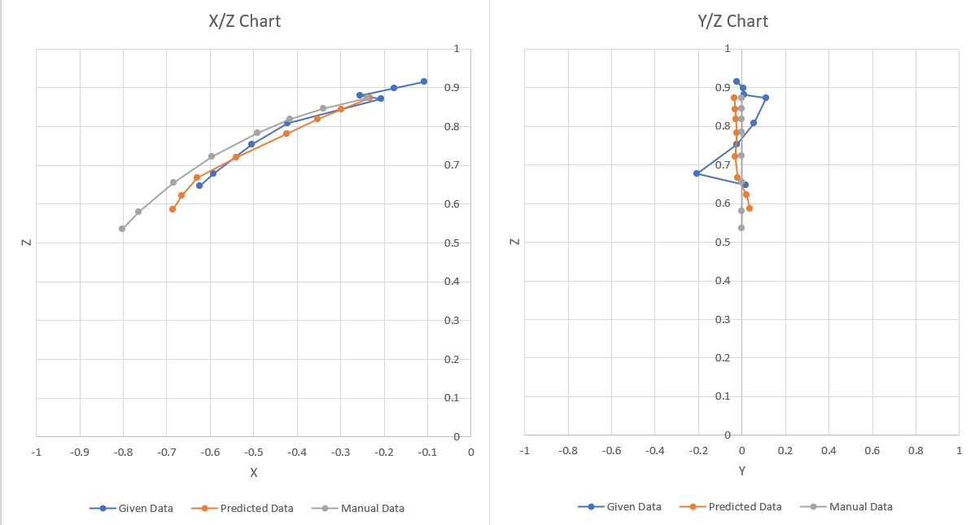
Compare given, predicted, and manual data points at points close to given data points

Slide 11
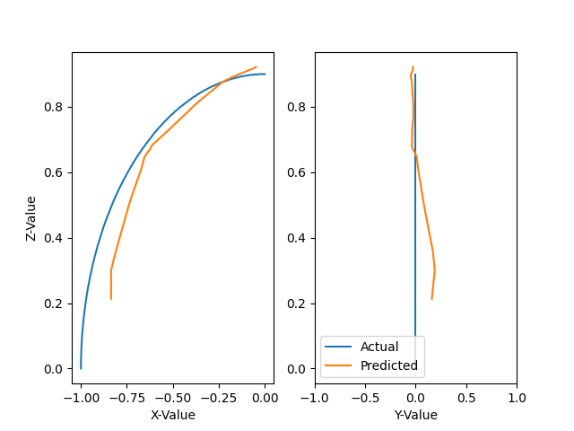
Forward model prediction on only negative motor 2 rotation

Slide 12
Inverse Kinematics Model
Tested the inverse model using the forward model’s predictions
Results made it clear that some of the motors are redundant
Motors 1 and 5
Motors 4 and 6
Cannot judge the accuracy from just motor positioning
There are many possible solutions
Input the inverse model’s predictions into the forward model again

Slide 13
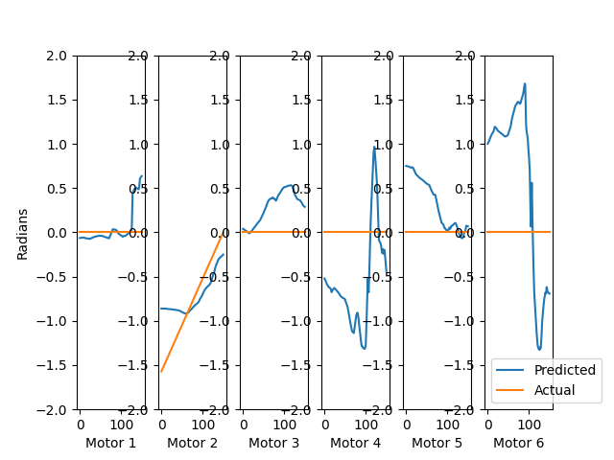
Inverse model predictions from forward model output
Notes:
See some redundancy

Slide 14
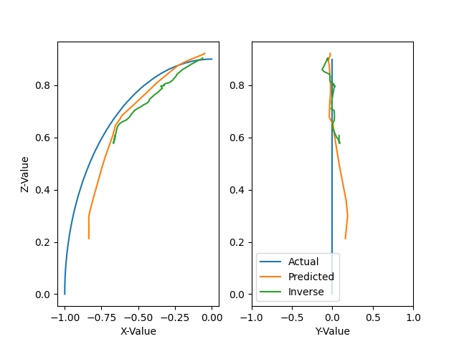
Comparing the Inverse Model’s Predictions to the Forward Model

Slide 15
The Inverse Kinematics Problem: Dealing with a One-to-Many Relationship

Slide 16
Literature on Neural Networks for Inverse Kinematics
Problem: Typical neural networks don't know how to handle multiple possible outputs
Possible solutions found in literature:
Modular approach
Partition training data according to output range
Train smaller networks on the specific ranges
Change the input/output relationship
Include current motor position
Best solution so far
Easiest to implement
Very effective at reducing joint angle error

Slide 17
“Supervised learning and excess degrees of freedom” by Michael I. Jordan
Configurational constraints
Don’t-care condition
Inequality constraint
Ranges
Linear constraints
Nonlinear constraints
Temporal constraints
State
Jordan network
Notes:
Configurational constraints- Limit to the way that the object can be configured
Temporal constraints- Assume the actions are implemented in a non-conflicting way
Combine the constraints and an optimality principle into a function to get an error function to be minimized to find the optimal solution
Configurational constraints:
Arise from fixed structural relations in the manipulator and environment
Don't-care condition- no constraints
Inequality constraint- error generated by activation required to be greater than or less than a certain threshold
Ranges- sum of the error of the two inequality constraints
Linear constraints- outputs are combined linearly into another layer for target values to be applied to
Nonlinear constraints- output is transformed nonlinearly before comparison with the target
Temporal constraints:
Involves actions that are close in time
Arise from dynamic properties of the manipulator and environment
State (which varies with time) is an input to the model in addition to the given input
Smoothness constraint- minimal change to perform a sequence smoothly and quickly
Jordan network- utilizes the states from the output as another input to the hidden layers

Slide 18
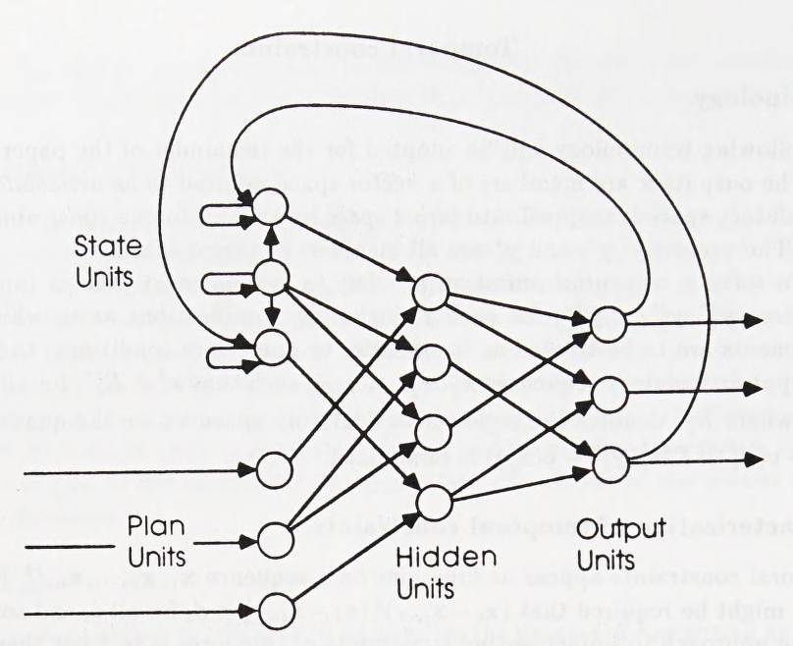
Jordan Recurrent Network

Slide 19
Simulation
Used a manipulator similar to the one used for practice
Taught it to hit buttons in a certain order
Was able to learn multiple sequences
Learning was generalized
Previously learned sequences affect new sequence learning
Resilient against model errors
Excess degrees of freedom allow its solution to minimize temporal constraints
More efficient movement
Notes:
Simulation:
Uses a manipulator with excess degrees of freedom in the simulations
Will only look at manipulator one, as that as the one that is relevant to the project
The excess degrees of freedom of the manipulator allow the solution to minimize temporal constraints
Was able to learn many different sequences
Learning was generalized, so learning time decreased with new sequences. Side effect: It was very sensitive to the relationship between sequences. Previously learned sequences affected the way it learned new sequences.
Resilient against errors in the model

Slide 20
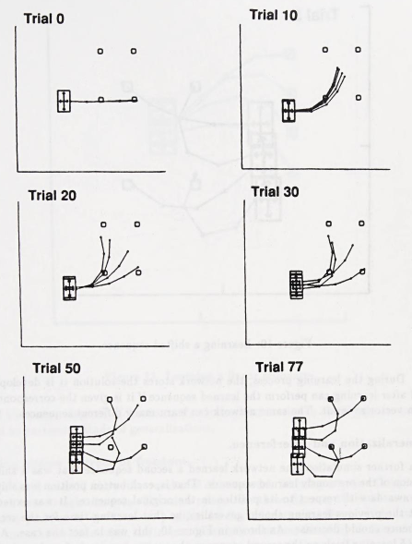
Manipulator’s sequence learning process

Slide 21
Works Cited
A. R. Almusawi, L. C. Dülger, and S. Kapucu, “A New Artificial Neural Network Approach in Solving Inverse Kinematics of Robotic Arm (Denso VP6242),” Computational Intelligence and Neuroscience, vol. 2016, pp. 1–10, Aug. 2016.
B. Damas and J. Santos-Victor, “An online algorithm for simultaneously learning forward and inverse kinematics,” 2012 IEEE/RSJ International Conference on Intelligent Robots and Systems, 2012.
M. I. Jordan, “Supervised learning and excess degrees of freedom,” in Artificial neural networks: Concepts and theory, P. Mehra and B. W. Wah, Eds. Los Alamitos, CA: IEEE Computer Society Press, 1992, pp. 245–285.
Kwok-Wai Lee and Tong Lee, “Design of neural networks for multi-value regression,” IJCNN'01. International Joint Conference on Neural Networks. Proceedings (Cat. No.01CH37222), 2001, pp. 93-98 vol.1, doi: 10.1109/IJCNN.2001.938998.
M. Shinki and K. Shimizu, “Approximation of inverse system (many-valued function) by neural network,” Electronics and Communications in Japan (Part III: Fundamental Electronic Science), vol. 84, no. 8, pp. 57–66, Apr. 2001.

